Slide 1

Differential Expression Analysis
Notes:
Now we are transitioning to learning about some key bioinformatics analyses
First one is Differential Expression

Slide 2
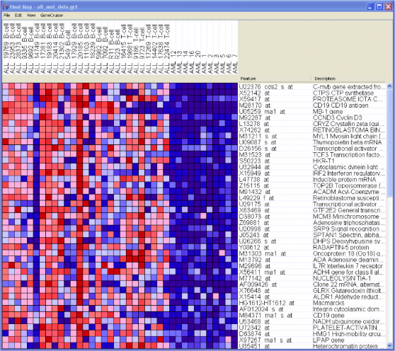
Gene expression matrix
Sample
annotations
Samples
Gene
annotations
Gene
expression
matrix
Genes
Notes:
one of the most common ways to represent and visualize data in GenePattern (and Bioinformatics in general) – Gene Expression matrix

Slide 3
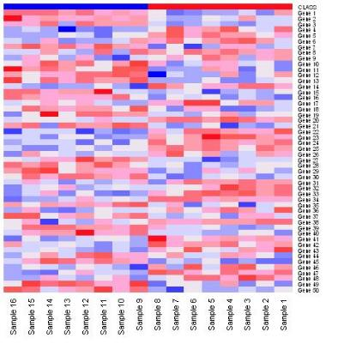
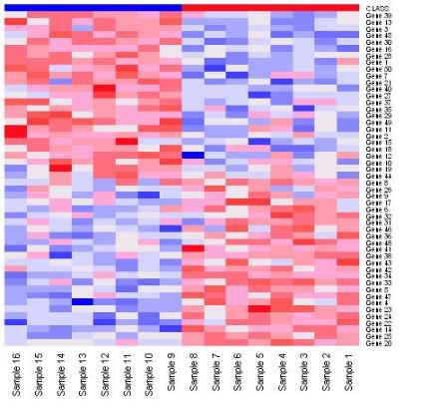
Differential Expression Analysis
Marker selection
Given phenotypically distinct classes, find “markers” that distinguish these classes from one another
Tumor
Normal
Tumor
Normal
Notes:
Marker selection is when given distinct classes, you want to find “markers” that distinguish between these classes.
The heatmap on the left show an unsorted heatmap, and on the right the genes are sorted by their ability to distinguish the two classes
Note that distinguishing the classes works both ways – up-and down-regulated in both classes.

Slide 4
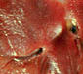
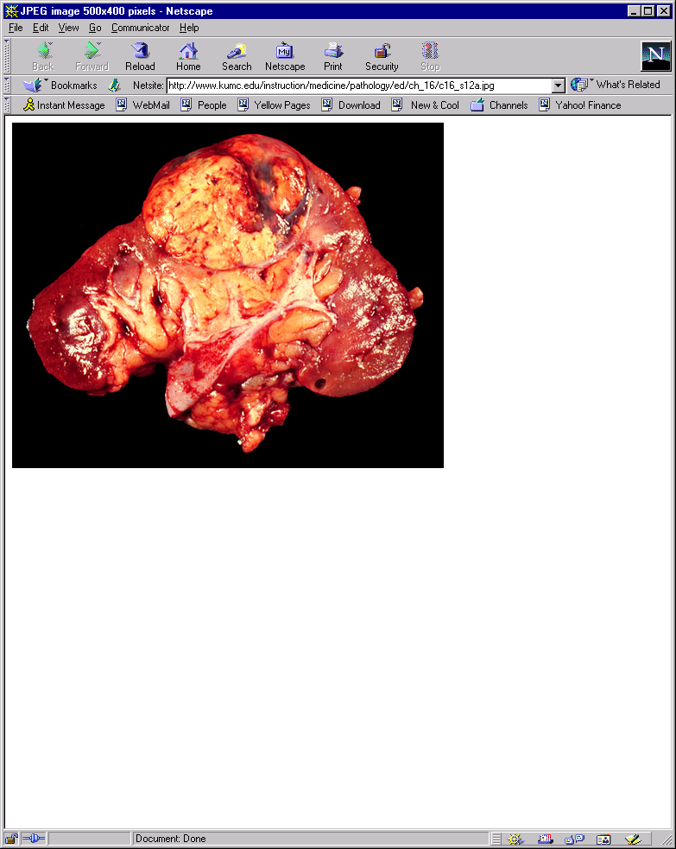
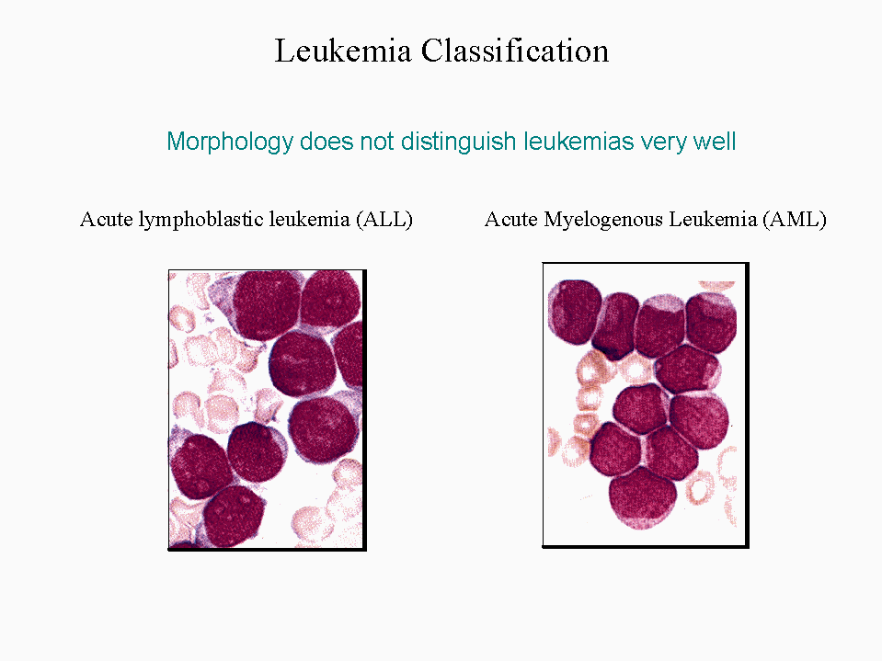
Gene Marker Selection
Hierarchy of difficulty
Problem Gene Markers Error Example
I. Tissue or Cell Type ~1000-2000 ~0% Normal vs. Renal carcinoma
Normal vs. Abnormal
II. Morphological ~200-500 ~0-5% Leukemia ALL vs. AML
Type
III. Morphological Subtype ~50-100 ~0-15% ALL B- vs. T-Cell
Multiclass Classification
IV. Treatment Outcome ~1-20 ~5-50% AML Treatment Outcome
Drug Sensitivity
Degree of Difficulty
adapted from P. Tamayo
Notes:
How difficult is it to find genes that distinguish between two conditions? Well it depends on the conditions you are looking at.
When doing marker selection there are several levels of difficulty
The first level is finding genes that distinguish between tissue or cell type – there are 1000s of markers
The second level is finding genes that distinguish between morphological types such as Leukemia ALL vs. AML
Outcome tends to be the most challenging to find markers for

Slide 5
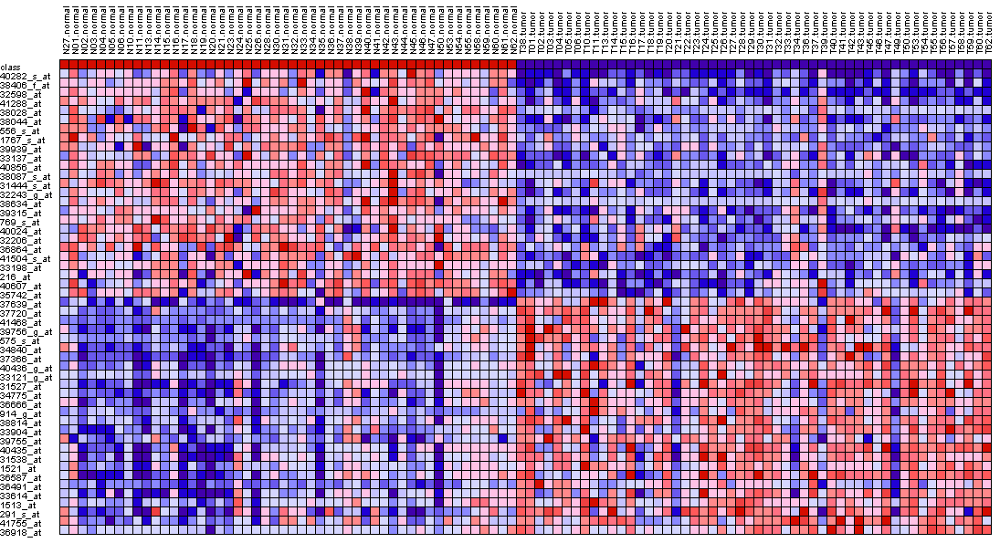
Gene Marker Selection
Compute score for each gene
Compute
score:
t-test,
SNR, etc.
Ranked gene list
Dataset
Score
Phenotype/
class labels
t-test
Signal-to-Noise
Ratio (SNR)
μ = class mean
σ = std deviation
n = # of samples
Standardized mean difference between the two classes.
It is the difference between the mean expression of class A and class B divided by the variability of expression.
Similar to the t-test but takes the standard deviation of the two distributions into account which is more representative of the differences between classes when there may be differences between the SD of class A and the SD of class B.
Notes:
Don’t go into t-test vs SNR

Slide 6
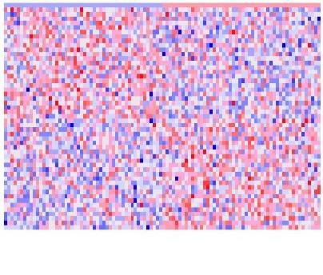
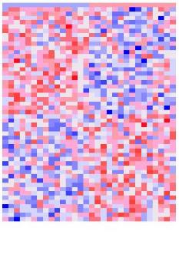
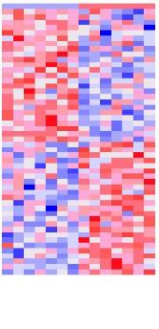

Effect of Sample Size
Exercise: select markers for random samples
Generate a 10,000x100 matrix of random data → N(μ=0, σ=0.5)
Pick n columns at random → n = [100, 30, 14, 6]
Assign label yellow (e.g., tumor) to half of samples (chosen at random) and green (e.g., normal) the rest
Select top 25 markers for yellow, top 25 markers for green
Yellow Green
Yellow Green
Yellow Green
Yellow Green
25
25
100 samples
30 samples
14 samples
6 samples
With small sample size it is easy to find genes considered significant by chance!
Notes:
Old notes:
Here we have 4 heatmaps with increasing sample size.
With small sample size, easy to find genes correlated w/ anything
Fit the story you want to tell – the fewer samples you have, the more likely you are to find samples that match by chance.

Slide 7
Differential Analysis Exercise
Open notebook:
2018-02-05_05_BroadE_Differential Analysis
Notes:
7
While DESeq2 is running, go over the last two slides

Slide 8
Differential Analysis Cookbook
Reduce number of hypotheses/genes by variation filtering (attempt at reducing false negatives)
Choose test statistic (e.g., SNR, t-score, ...)
If enough samples, compute p-values by permutation test (otherwise, compute asymptotic test using the standard t-distribution).
Control for Multiple Hypothesis Testing by using the FDR correction
Remember: if you choose FDR ≤ 0.05, you’re willing to accept 5% of false positives.
If number of significant hypotheses/genes “too large” even for very small threshold values, either:
use the maxT correction (possible w/ empirical p-values only).
use additional criteria (e.g., min fold-change, min expression value, etc.)

Slide 9
Differential Analysis
GenePattern modules
Create count data set
Filter and transform data– PreprocessReadCounts
Make class/phenotype file - ClsFileCreator
Run Differential Analysis – ComparativeMarkerSelection
Choose test statistic (say, t-test)
View results with ComparativeMarkerSelectionViewer
If enough samples, compute p-values by permutation test (otherwise, use asymptotic test).
Control for Multiple Hypothesis Testing by using the FDR correction
Use HeatMapViewer to view results for top genes
Use GSEA to find gene sets (or pathways) that are enriched in your dataset – coming up after the break!

Slide 10
Lunch

